Slide 1

UBER SUPPLY-DEMAND GAP
SUBMISSION
-Bharath Kumar B.S

Slide 2
UBER - Introduction
Uber is peer-to-peer ridesharing, taxi cab, food delivery, bicycle-sharing, and transportation network company.
Its headquartered in San Francisco , California.
Its platforms can be accessed via Web platforms and mobile apps.
Business Objective
Identifying Root Cause of the cancellation and non-availability of cars.
Recommend ways to improve the situation and decrease potential loss of revenues.
Limitations
  Only trips to and fro from the airport are considered

Slide 3
Data Understanding
The Uber Data has 6745 observations of 6 variables each.
There are six variables associated with each requests.
  Request ID : Unique ID for each request.
  Pickup Point : Pickup point which is either Airport or City.
  Driver ID : Unique Id for each driver. Null in case of No cars available request.
  Status : Status of the request. The values are Trip Completed, No Cars Available, Cancelled.
  Request Time Stamp : Time of the request.
  Drop Time Stamp : Time of the request was completed.NA in case the request was Cancelled\No Cars Available.
We are considering Demand as records with Status – Trip Completed,No Cars Available and Cancelled and Supply as records with Status – Trip Completed.

Slide 4
Data Cleansing and Manipulation
Request Time Stamp and Drop Time Stamp are either separated by \ or - . Convert it to a uniform format to help in conversion and analysis.
All the time stamps are converted to Date format.
For analysis we derive Date and Time from the Time Stamps and save it separately in data frame.
We also derive hour from Time Stamps and save it.
We group Hours into Time Slots for analysis purpose. For this purpose we consider the hours into time slots as below.
  Early Morning – 2am to 5am
  Morning – 5am to 12 pm
  Afternoon – 12pm to 4pm
  Evening – 4pm to 10pm
  Night – 10pm to 2am.

Slide 5
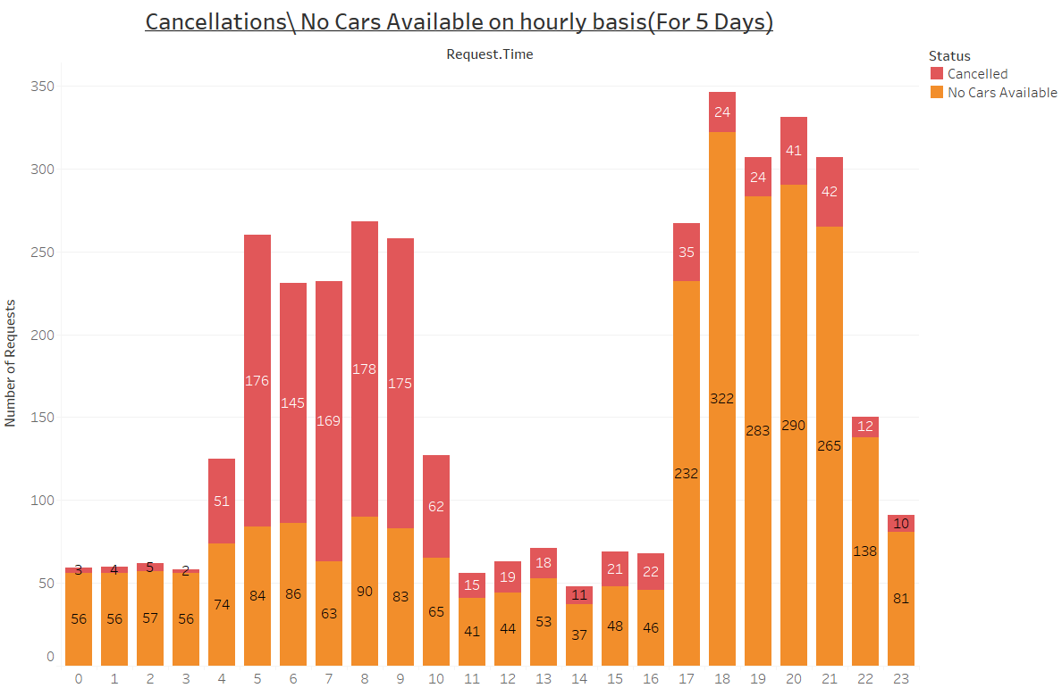
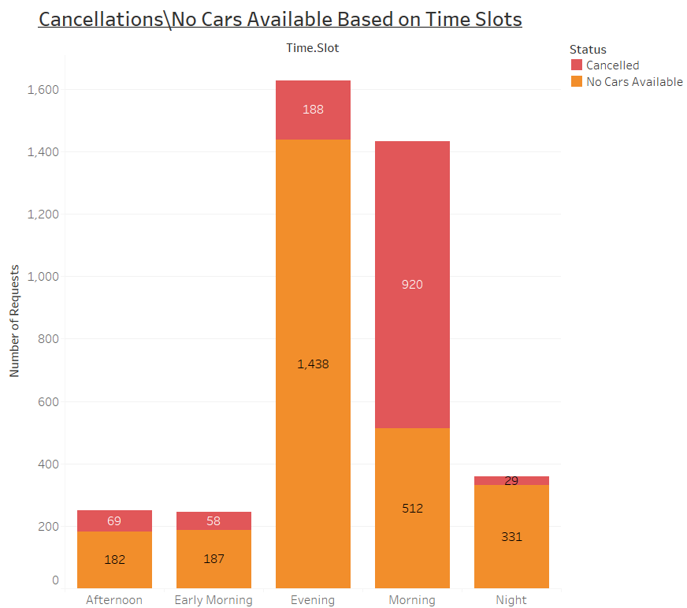
Request Analysis – Cancellation\No Cars Available
Plot showing Cancellations\No Cars available on hourly basis for 5 days from both Airport and City.
Plot Clearly shows that we have lot of Cancellations\No Cars Available between 5am to 9am and 5pm and 9pm.
Plot showing Cancellations\No Cars available on Time Slot basis for 5 days from both Airport and City.
Plot Clearly shows that we have maximum no of Cancellations\No Cars Available during Evening and Morning.

Slide 6
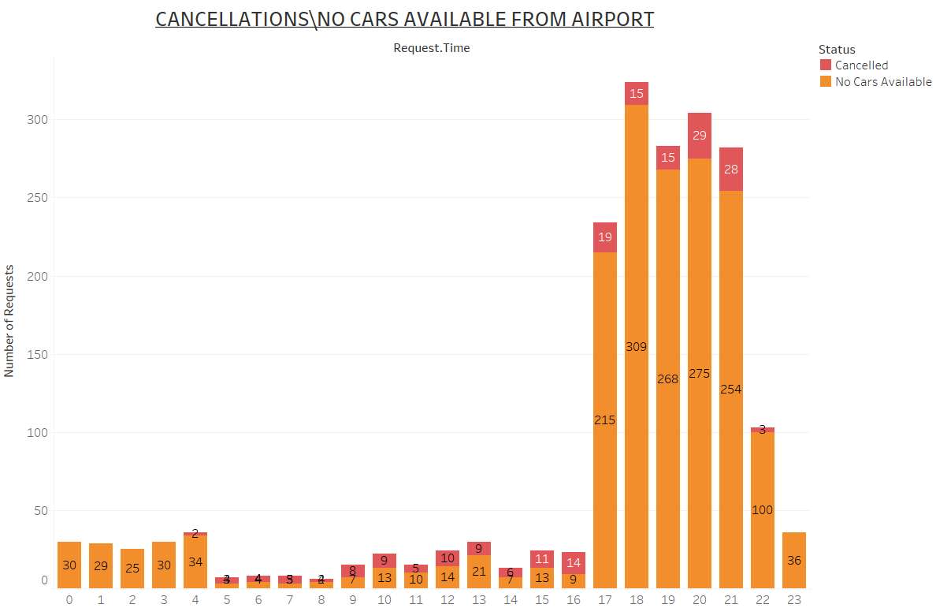
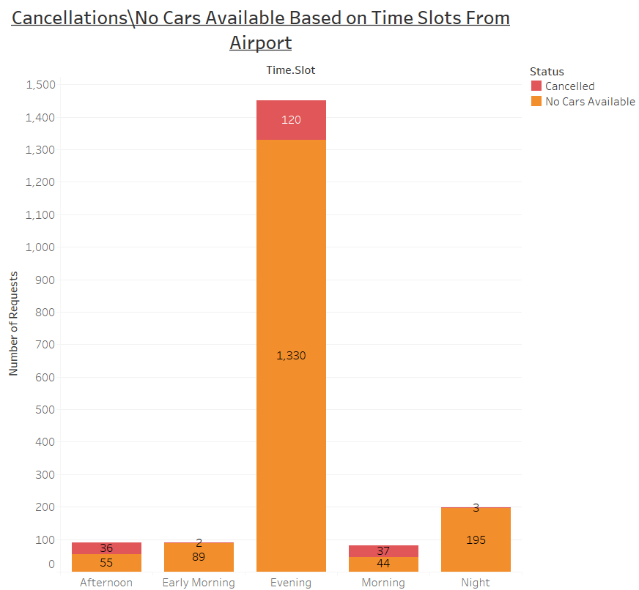
Request Analysis – Cancellation\No Cars Available from Airport
Plot clearly shows that we have maximum number of Cancellations\No Cars Available from Airport during 5pm to 9pm on hourly basis.
Plot clearly shows that we have maximum number of Cancellations\No Cars Available from Airport in Evening on Time slot basis.

Slide 7
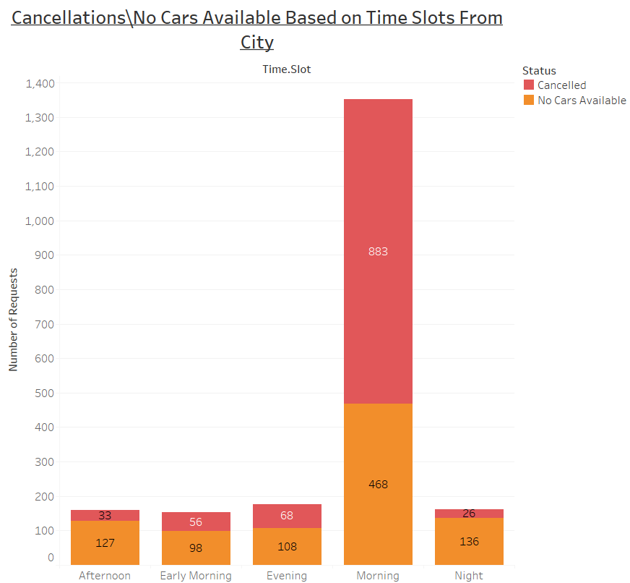
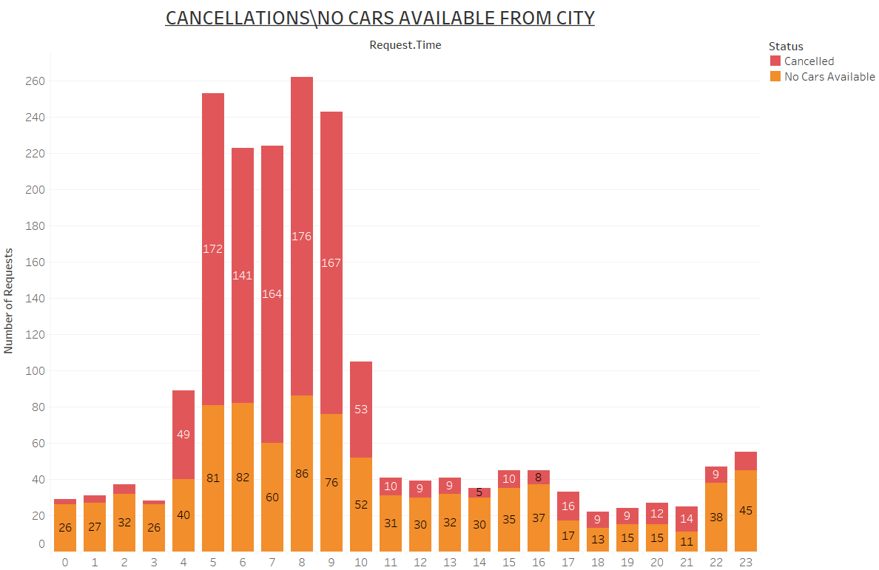
Request Analysis – Cancellation\No Cars Available from City
Plot clearly shows that we have maximum number of Cancellations\No Cars Available from City during 5am to 9am on hourly basis.
Plot clearly shows that we have maximum number of Cancellations\No Cars Available from City in Morning
on Time slot basis.

Slide 8
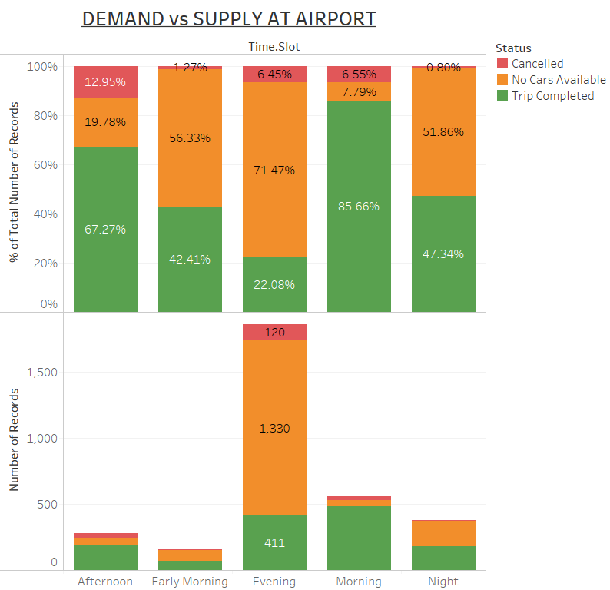
Demand And Supply Gap at Airport.
Plot clearly indicates that in Evening we have a severe gap between Demand and Supply.
Only 22.08% Requests are successfully processed at Airport in Evening Time Slot.
Out of 1861 Requests in Evening , Only 411 were successfully processed.
Most of Gap is due to Unavailability of Cars in Airport during Evening.

Slide 9
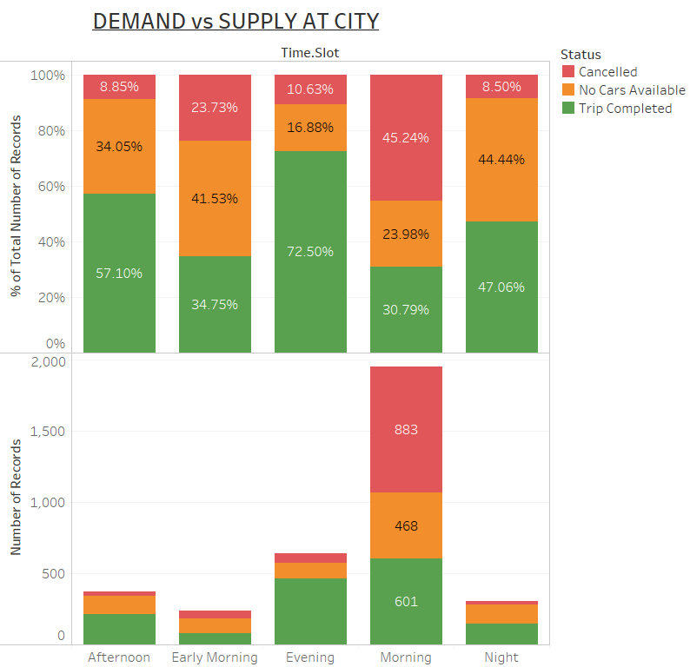
Demand And Supply Gap at City
Plot clearly indicates that we have severe gap in Demand And Supply in Morning Time Slot in City.
Only 30.79% Requests are successfully processed at Airport in Morning Time Slot.
Out of 1952 Requests in Morning, Only 601 were successfully processed.
Most of Gap is due to Cancellations done by driver in Morning.

Slide 10
Recommendations
City Trips
Drivers can be given extra bonus for each trip they complete from City to Airport in Morning Slot . This will reduce the number of cancellations.
Uber can also pay some incentives for drivers for their Waiting Time at Airport in Morning Time.
Airport Trips
Uber should increase the number of cabs in Airport during Evening. This will reduce the number of Non Availability.
Drivers are paid extra bonus to complete trips from Airport in Evening Slot.

